Slide 1

What is coding And how can it help us? Steve Grigg - Australian ACD Lead
Notes:
Welcome
Intro Me
Intro to the presentation –
Overview of what Coding/ programming is.
How this links into our strategic priorities for the region
The ACD Team and their role in supporting these initiatives
The Re launch of Coding Clubs for 2021

Slide 2
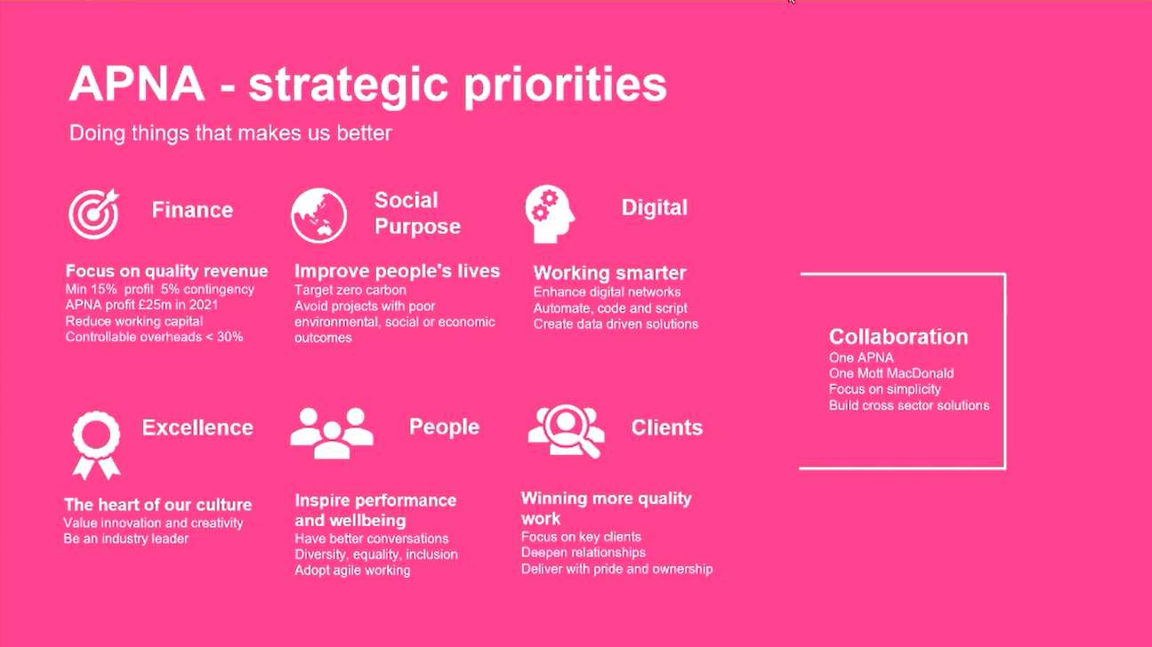
Notes:
Ref slide recently shown – APNA Strategic priorities
Key theme – Digital – Work Smarter, Not harder. What does this mean?
Leverage automation, let the computers do the repetitive work – We can focus on the real problems.
Pockets of excellence across offices in Australia, and globally
Advanced Computational Design Team are here to support the wider MM team

Slide 3
DDN
BIM
GIS
ACD
Data Science
Notes:
DDN – Digital Delivery Network
Driving Digital Capability via Training & Professional Development across all Sectors, Practices & Disciplines
4 Communities – All complement each other
Lots of overlap between them

Slide 4
Automation and Computational Design
Digital Fabrication
Coding
Artificial Intelligence
Visual Scripting
Automation and Computational Design
Visualisations
Automation
Mixed Reality
Data Automation
Parametric Design
Augmented Reality
Generative Design
Algorithmic Design
Machine Learning
Notes:
What is ACD – a community part of DDN formed in 2019
Diverse set of skills covering several fields
Key Objectives –
Strengthen existing community – encourage collaboration and best practice
Support strategic business development – Strategic bids, project Support, Implementing new ways of working on existing projects
Grow the number of data literals, use coding to automate – deliver better outcomes – One way = Coding Clubs
Hackathon per year

Slide 5

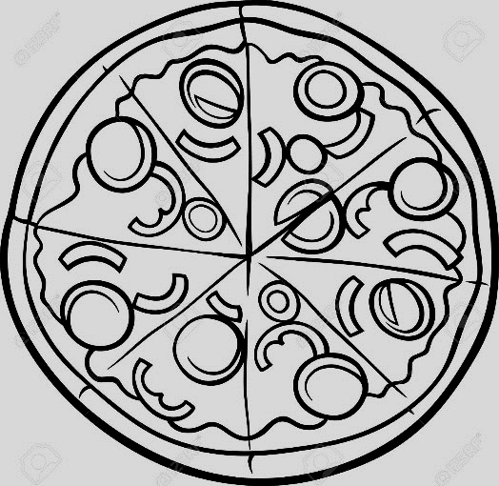

What is Coding?
Ingredients
Recipe
Pizza
Inputs
Operations
Output
Notes:
Before we go too far – What is a programming language?
How do we communicate with a computer?
Computer only recognises binary language.
Simplified slide

Slide 6
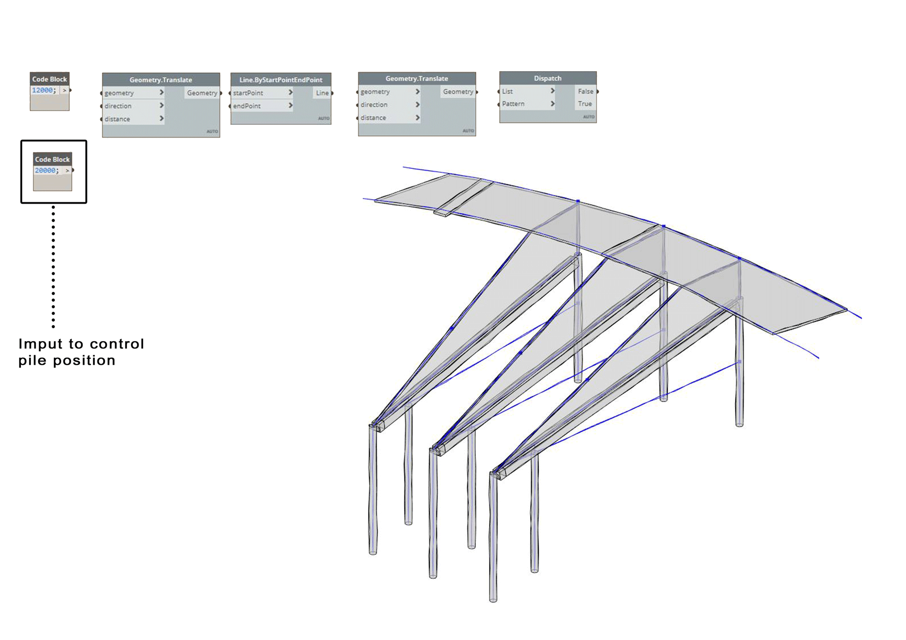
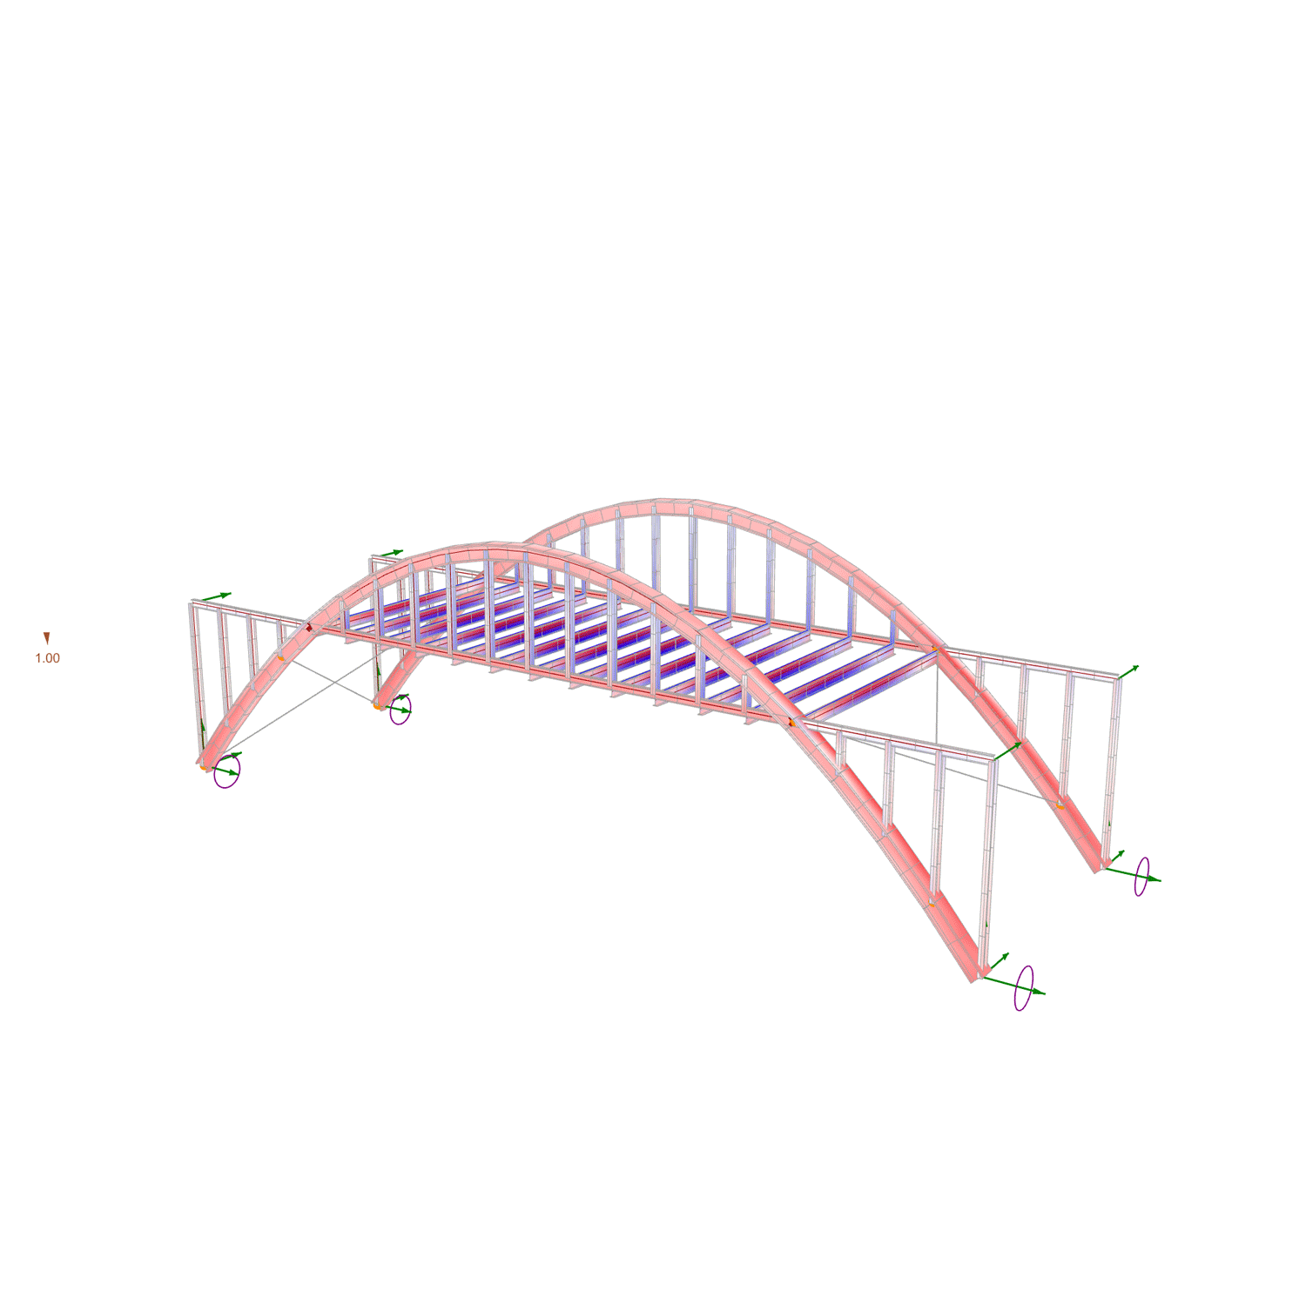
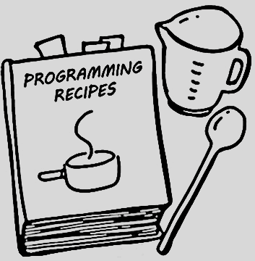

Inputs
Operations
Output
IMG
External Data
Parametric geometry
CSV
DWG
TXT
Slider
7 -------[]--------------->
String
Apples, Eggs, Lemon, Chocolate
Updated model data and project documentation
Revit or Civil 3D element
3D Model
Imported SAT, DWG, IFC, etc
Model data
Element parameters
Optimisation, generative design and model analysis
Notes:
Inputs:
Data Files
Code inputs
Standard data from libraries
Model data
Flour, eggs, milk
Operations
Computer processing the inputs
Outputs
Generative design
Model
Visualisation
Comparison
Check/ compare
results

Slide 7
What is Programming Language
1
2
Computers use a language called binary code which comprises of ‘0’ and ‘1’ 0 = off / Disabled/ False 1 = on / Enabled / True
Communicating with a computer in just ‘0’ and ‘1’ would be very difficult and time consuming
3
4
We use a programming language that can translate information into binary code
There are many programming languages, often used for different purposes
Notes:
Before we go too far – What is a programming language?
How do we communicate with a computer?
Computer only recognises binary language.
Programming languages are created to help write code without having to use the 0s and 1s.
communicate with a computer:
How to receive inputs
Collect, store, process data
Deliver outputs
Custom tools then combine the code and translate it back into 0s and 1s later so that the computer can understand.
Common languages – Java, Python, Ruby, C, C# JavaScript
Also visual programming – drag and drop functions and modules into a working environment – Grasshopper/ Dynamo

Slide 8

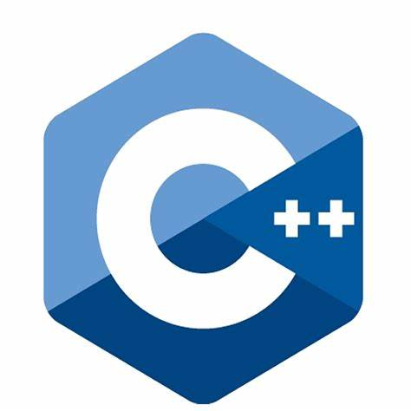




What is a Programming Language
Common Programming Languages
Web Development
Javascript is commonly used by web developers including the website layout, creating immersive and interactive content
Software and Applications
Specific languages for each platform. For example creating an app for an iphone will be a different language to creating an app for android
Scientific
Clean, simple to use languages, usually number intensive and good at solving mathematical equations
Visual
Visual programming uses node based interface that does not require the writing of code. Used for repetitive tasks, analysis and complex geometry.
Grasshopper = Rhino Dynamo = Revit
Notes:
Common languages – Java, Python, Ruby, C, C# JavaScript
Also visual programming – node based.
drag and drop functions and modules into a working environment – Grasshopper/ Dynamo
Visual programming Does not require traditional coding, although can be linked with other coding languages
Used for repetitive, complex tasks, geometry, analysis

Slide 9
What is Programming Language
Natural Language vs Programming Language
Myth | Truth
Lots of maths | A good foundation in Maths is sufficient
Tertiary education in computer science | Can be as simple as using an Excel spreadsheet
Dry maths in IT land | Successful examples in natural science, fine arts, sociology, environmental industries
Change of profession | Bring domain experts to the next level in their specialities
Requires expensive soft / hardware | Most soft / hardware and supporting resources are FREE!
Notes:
Maths skills not directly proportional to programming skills.
Problem solving, analytical and logical thinking ability an advantage
Libraries and plugins available to directly use in your code, to solve the mathematical problems.
Education – Not required. Time and effort required to learn and gain experience.
Change of profession – Makes you a more well rounded individual by bringing that domain experience and adding new skills
Software – Mostly free!!!

Slide 10


Automation & Computational Design – Coding Clubs
Digital Delivery Network (Practice)
“Automation & Computational Design” a community part of DDN formed in 2019
Global initiative “Advanced Computational Design” + “Automation, Coding & Scripting”
Previous launch of “Coding Club” in Cambridge and Auckland
“Coding Club” to be launched in Australia in 2021
Python
and many more…
Target audience: Technical + Non-Technical Team
Notes:
Introduction to Coding Club 2021 (10 min)
Motivation / objectives, how it will run, target audience, upcoming topics (dynamo)

Slide 11
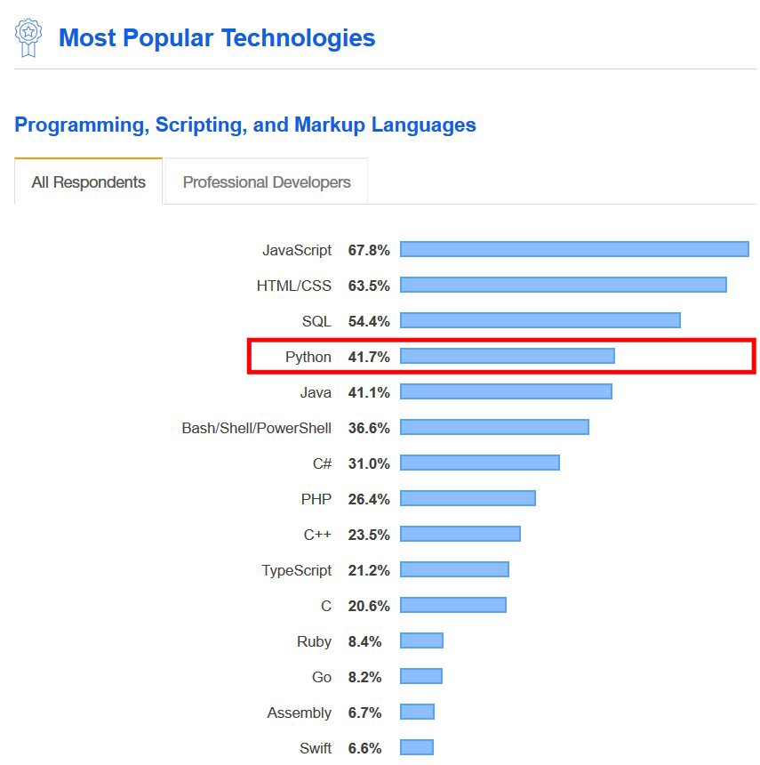
Why Python
General-purpose (flexible) language, developed platforms e.g. YouTube, Google Search and iRobot machines
Easy to learn and use, ideal for beginners
Well-supported community with extensive libraries
Test as it goes, reduce time on creating and testing lengthy code
Notes:
Python (10 min)
What is it, history, why python, open source, libraries
Capabilities, practical uses, examples

Slide 12

Dynamo Practical Uses
Notes:
Automating the placement of structural members in a stadium design
Needed ability to update the placement of members quickly and easily
Sightlines, Seating, aisle widths etc.
For This project in New Zealand, we needed to be able to update the model and drawings quickly, and potentially late in the design process due to late changes or additional information.
Value
Up-Front time and effort required to develop the script
Solution is developed once, but has flexibility to adapt to change
Making changes to the model can be achieved in hours rather than days/ weeks.
Bring the client on the journey

Slide 13

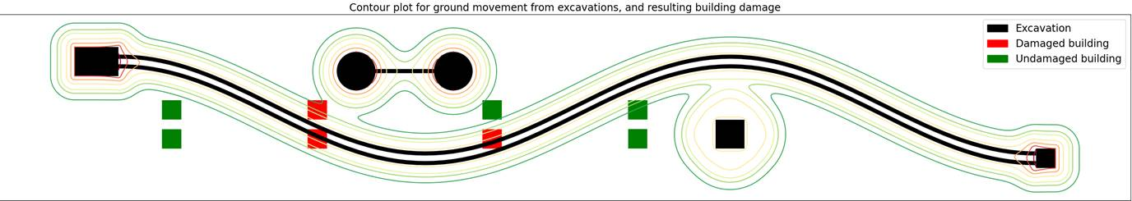
Python Practical Uses
Ground Movement from excavations
Tool to predict ground movement due to excavation
Large amount of data needed to be processed in multiple formats
Using Python saved countless hours of manual work
Analysis was optimised to compute 1000x faster by making smart use of the information.
Notes:
Example shared by team in Sydney office
Shows ground movement due to excavation
Black – Excavation
Red – Damaged building due to excavation
Green – No effect from excavation
Value:
Script was able to be optimised to speed up processing
Adaptable and scaleable if new data provided
Model can be re-run quickly, and results output in minutes or hours, rather then days or weeks.

Slide 14
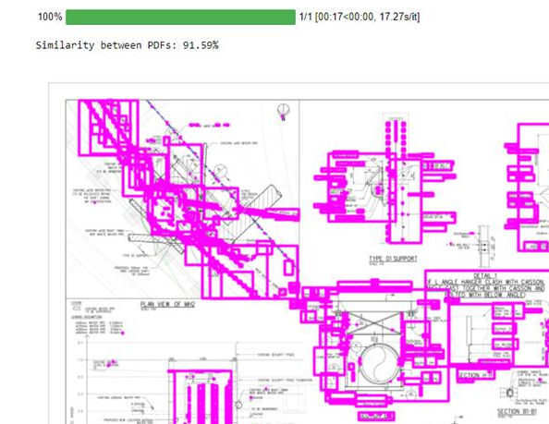
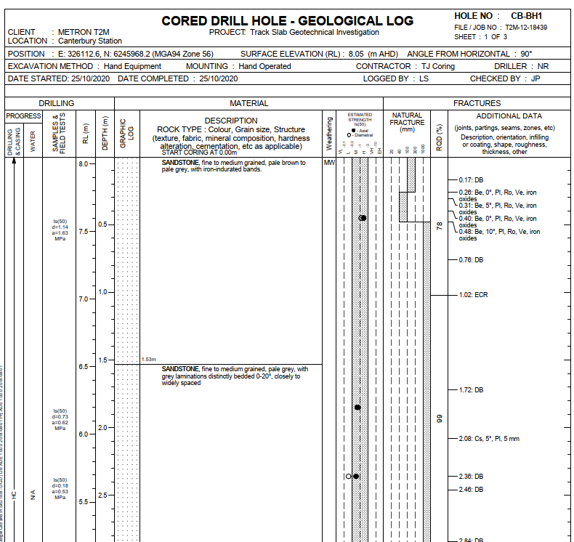
Python Practical Uses
Computer Vision
Data Processing
Notes:
borehole, based on Pells classification system for Sydney shale and sandstone
based on various thresholds for fracture spacing, unconfined compressive strength and seam thickness

Slide 15
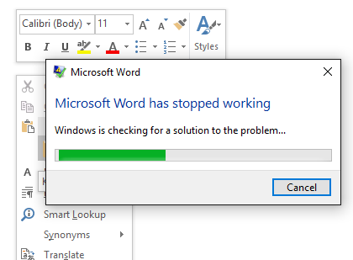
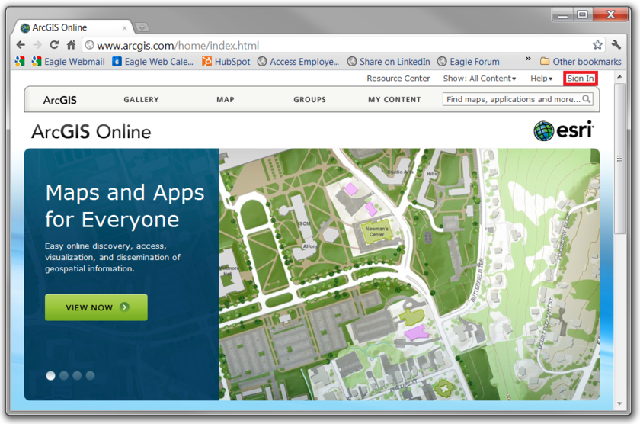
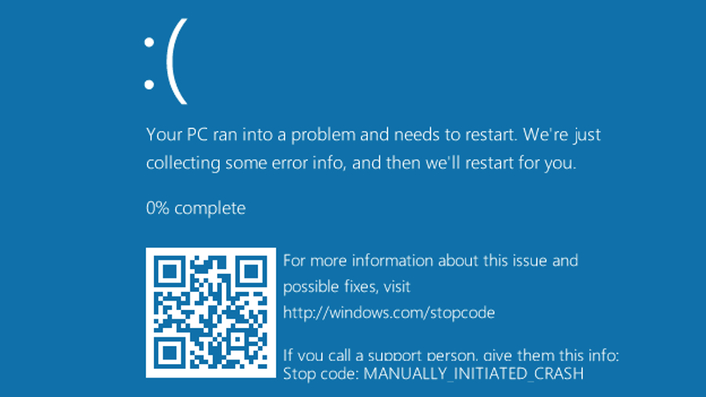
Python Practical Uses
Natural Language
Internet Scraping

Slide 16
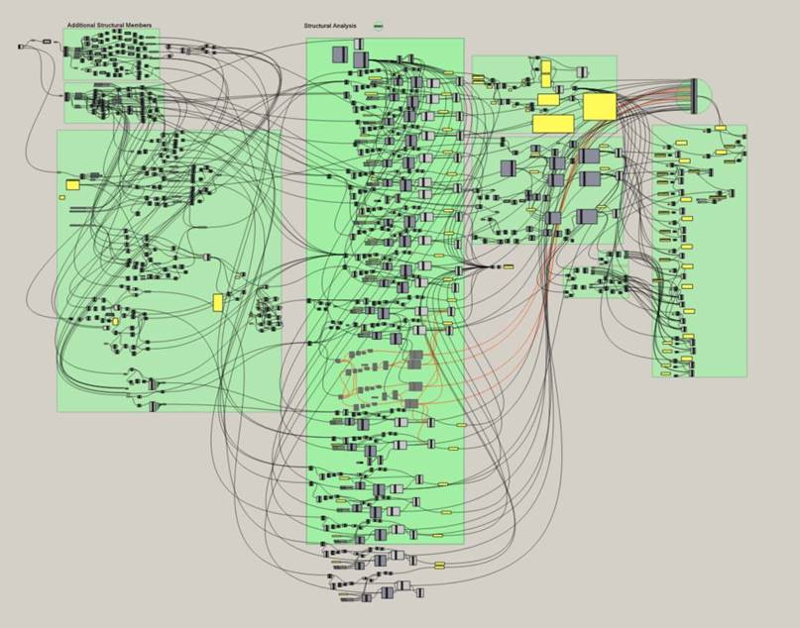
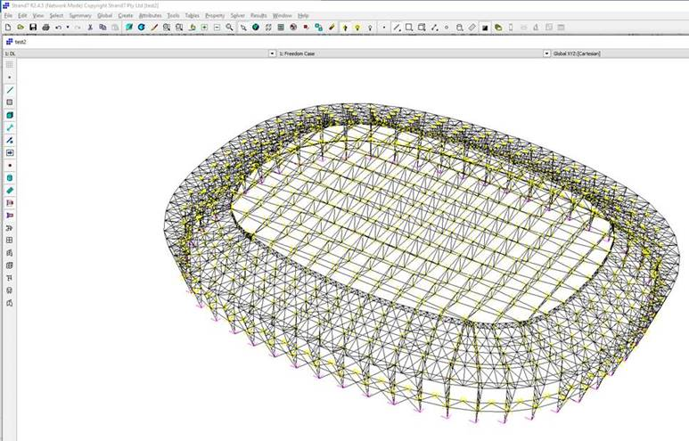
Other Practical Uses
Grasshopper
Notes:
Example provided by team in QLD – Automating the layout of structural steel in a structure
Grasshopper is another visual programming tool
Image on the left is the canvas – individual nodes – each one a command or series of commands
Inputs and outputs
Linked together by the connectors
Value:

Slide 17
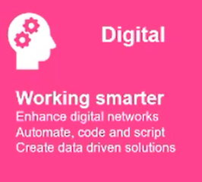
Practical Uses
Summary
Automation
Increased efficiency
Adapt to changing requirements
Enable teams to focus on the real problems
Notes:
Link back to APNA Strategic priorities

Slide 18
Coding Clubs
Learn to code training program
Increase number of staff able to code across all offices
Weekly sessions run in each office
Python
Notes:
So far.
Given a brief overview of what programming/ coding is and why we do it.
Also talked about why its important for us at MM.
So how is the ACD team supporting you wit this?
Not a new thing to Mott Macdonald. These have been run across officed for a number of years
This year – consolidated approach, targeting key development objectives – Python and Dynamo.
Robust, training program, led by our own Leaders in the field
Intended to upskill beginners, and to push the boundaries for advanced practitioners

Slide 19
Coding Clubs
Outline
10-15 mins
Review last weeks topic, discuss the solutions that were reached.
15 mins
Introduce the club to the current weeks content.
60-90 mins
Time to code.
Work on the content for this week.
6 weeks course.
Python
Notes:
Plan will be to have a presenter in each office presenting the content
We will aim to have support people present also – people with a basic understanding of the coding language being worked on
Aim to have 2 presenters per office to share the responsibility

Slide 20
Python Coding Club Overview
Week 1
Coding Process Overview
Week 2
Computer Vision
Week 3
Excel Manipulation and Data Processing
Week 4
Week 5
Natural Language with PDF and Word
Week 6
Internet Scraping
Real Time data extraction
Python
Notes:
1 – How to code from cradle to grave
2 – enables computers to derive meaningful information from digital images – reviewing a set of drawings for example
3 – Compile design data from multiple sources
4 – Automated text search and interpretation
5 – Online data searching, reviewing and downloading
6 – Live data dashboard from multiple sources

Slide 21
Beginner Modules
Intermediate Modules (TBC)
Session 1 – Coding Process Overview
How to code from cradle to grave
Session 1 – API integration
Session 2 – Computer Vision
Engineering drawings reading
Autonomous Vehicles
Session 2 – Big Data & Data Science
Session 3 – Excel Manipulation and Data Processing
Compile design data from multiple sources into custom format
Future Prediction
Session 3 – Artificial Intelligence & Machine Learning
Session 4 – Natural Language with PDF and Word
Automated text search and interpretation
Sentiment Analysis
Session 5 – Internet Scraping
Online data parsing
Headless Machines
Session 6 – Real-Time Data Extraction and Concluding Remarks
Live dashboard from any source
IoT & Digital Twins
Python
Notes:
Python x6 sessions (10 min)
Syllabus, structure, duration
Separable, implementable, non-technical + technical
Season 2
Aim to have minimum 2 presenters/ facilitators per office to alternate responsibility
Ideally sessions are run in person
Virtual sessions capped to 90 minutes duration

Slide 22
Coding Club – Office Support
Adelaide – Benjamin Bleckly
Melbourne – Kalyan Kamepalli
Sydney – Tony Ridley
Brisbane – Andrew Cato
Notes:
For details or questions feel free to reach out to me,
Alternatively your office support people

Slide 23
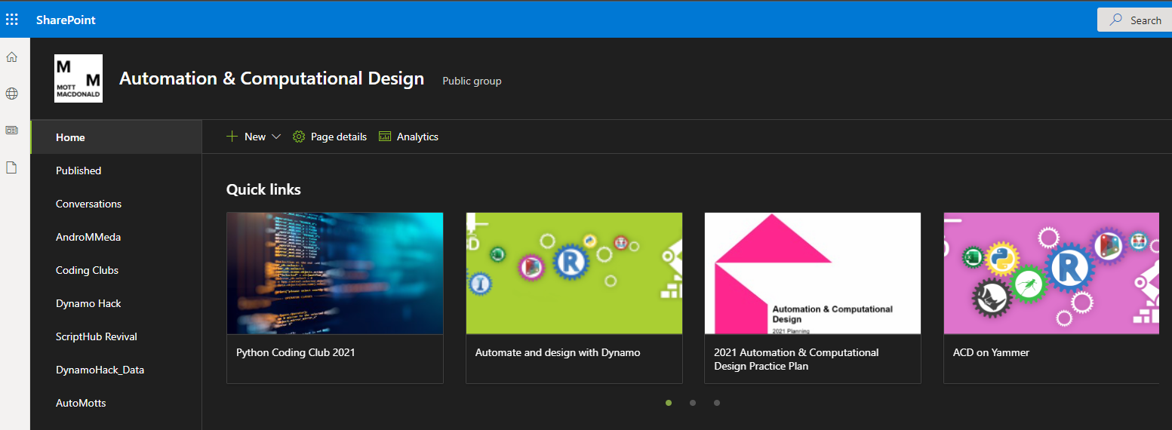
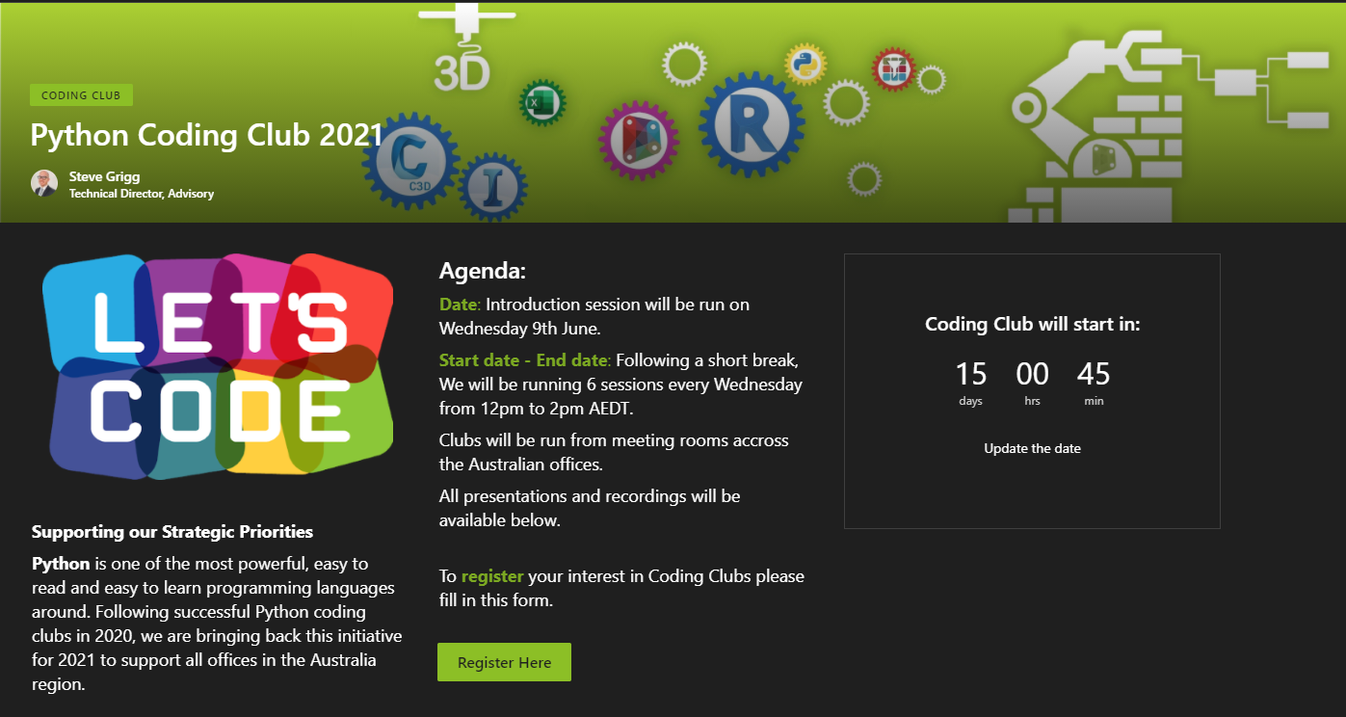
What’s Next?
Automation & Computational Design - Home (sharepoint.com)
Details of upcoming coding club can be found here
Complete short registration form

Slide 24
Thankyou

